Slide 1
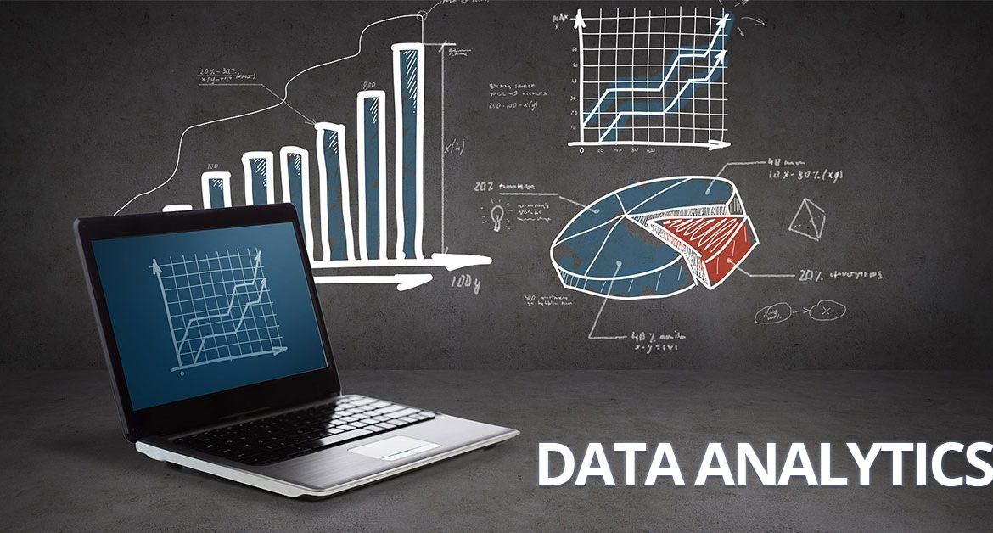
Welcome To The Data Analytics Course
December 3, 2018
Course Introduction and Overview

Slide 2
Agenda
Get up and running with hardware, software and Internet connections
What are data analytics?
What can they do for you?
Course Overview
Instructors
Class
Syllabus
Learning Objectives
Programming Language
Why not excel
Why R
What else would you use

Slide 3



Administrivia
You should:
Have a computer in front of you
Have R installed on that computer
Have a connection to the internet
If you do not have all of these three please let us know so we can start trouble shooting ASAP.

Slide 4

What are data analytics?

Slide 5
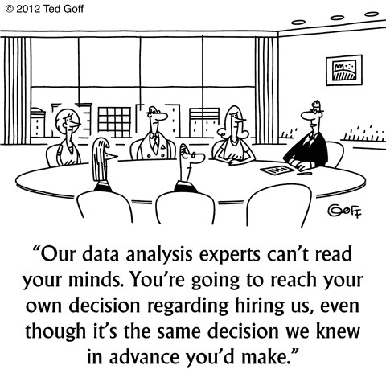
What are data analytics?
Can refer to:
Data-based decision making
Exploratory data analysis
Predictive Modeling
Computer-assisted data analysis
Programming
Typical elements
Programming
Focus on modeling

Slide 6


Who are you what do you want data analytics to do?

Slide 7
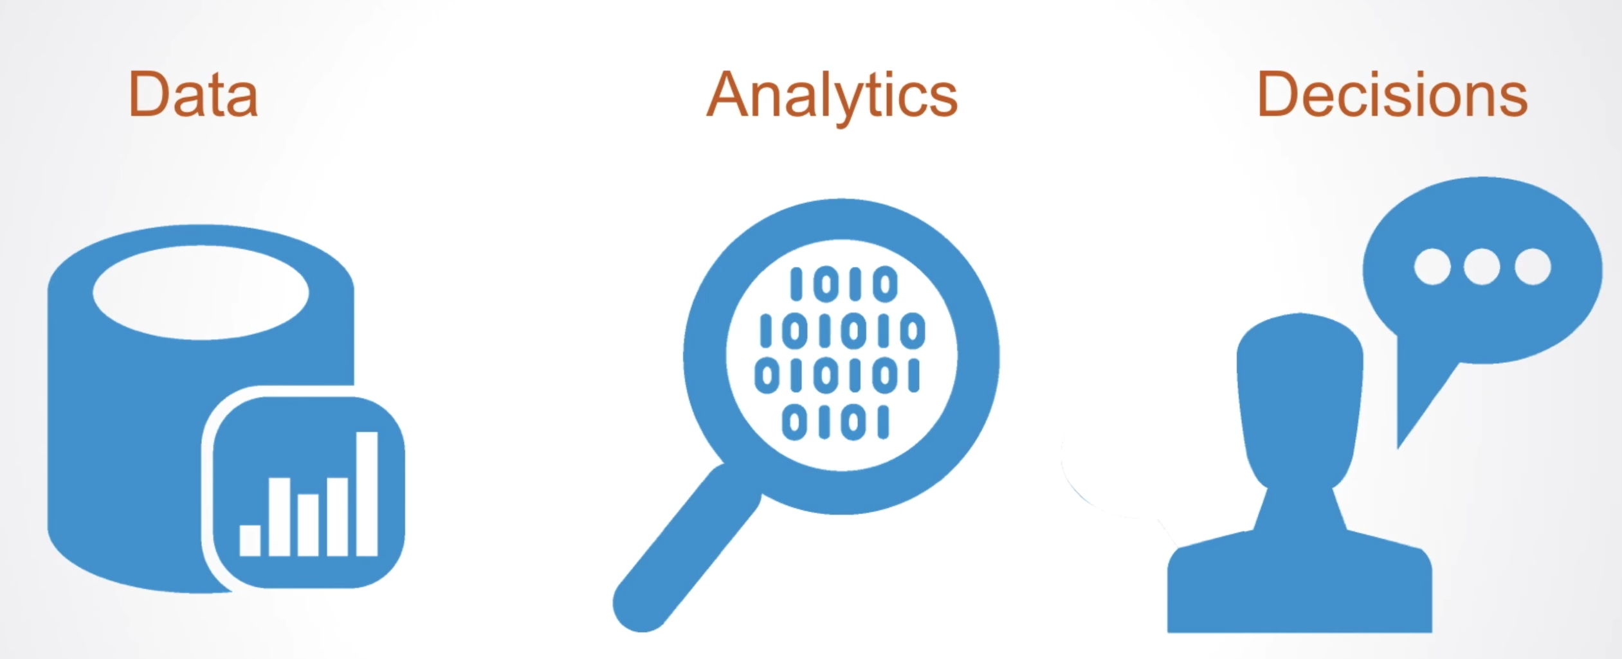
What can data analytics to do?

Slide 8


What can data analytics to do?

Slide 9

What can data analytics to do?

Slide 10
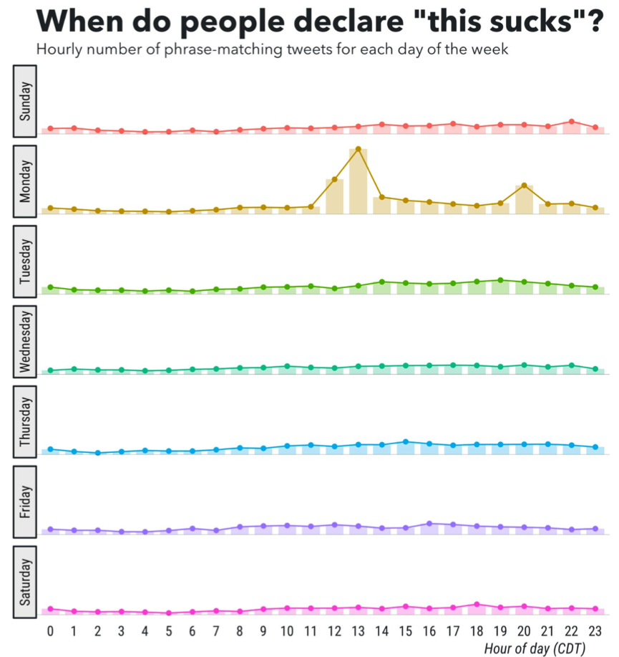
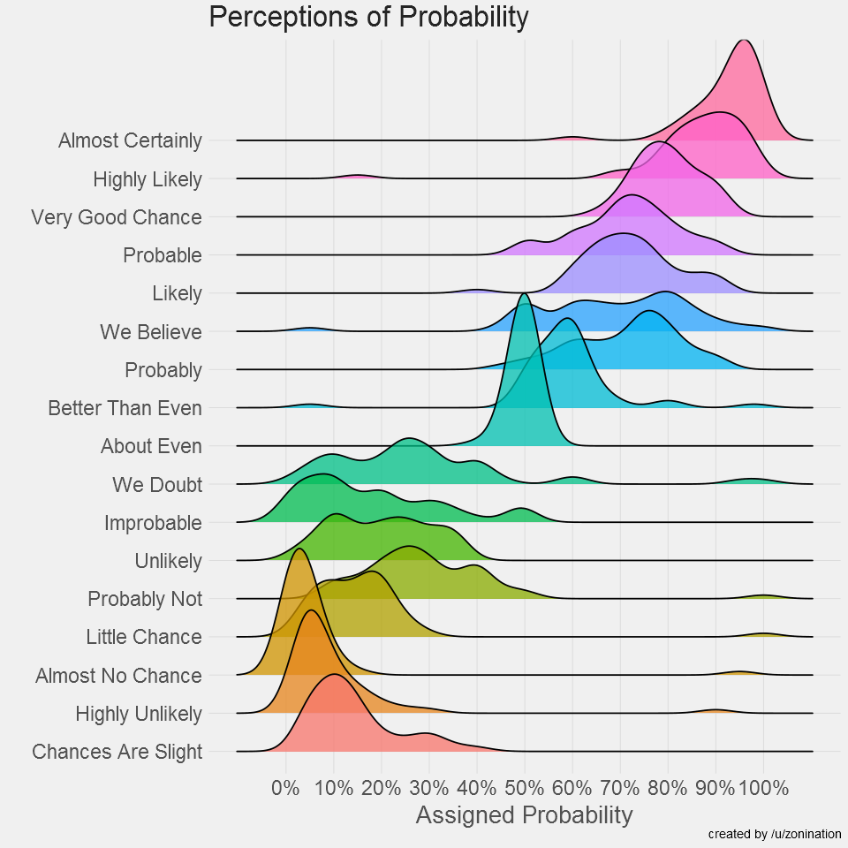
What are data analytics in R?
R is an incredibly powerful tool
Both create and deploy data analytics
Example: https://gallery.shinyapps.io/drinkr
Code: https://github.com/rasmusab/drinkr/tree/master/shiny_app

Slide 11
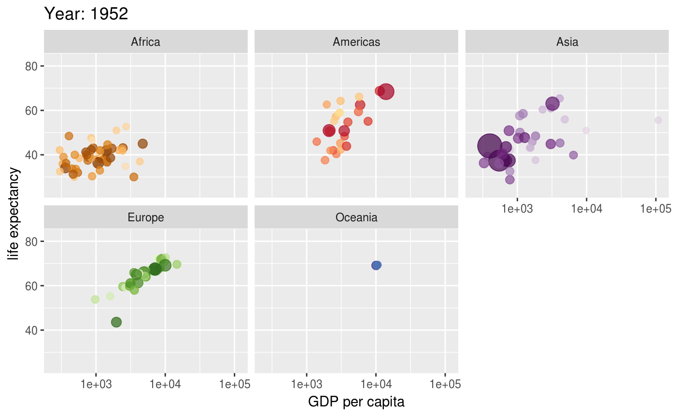
What are data analytics in R?
R is an incredibly powerful tool

Slide 12
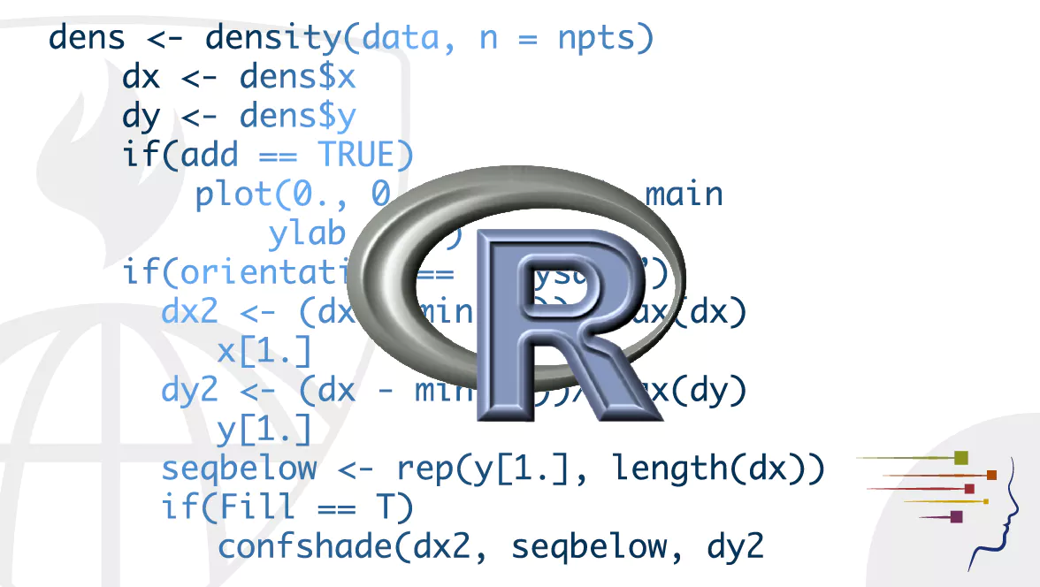
Focus on programming
Learning to speak to computers:
Think like a computer
Instruct them to do your intentions
Data analysis tasks
Incredibly Powerful
Opens up creative pathways
Upon course completion you will be able to think of at least one entirely new question that now you can address.

Slide 13
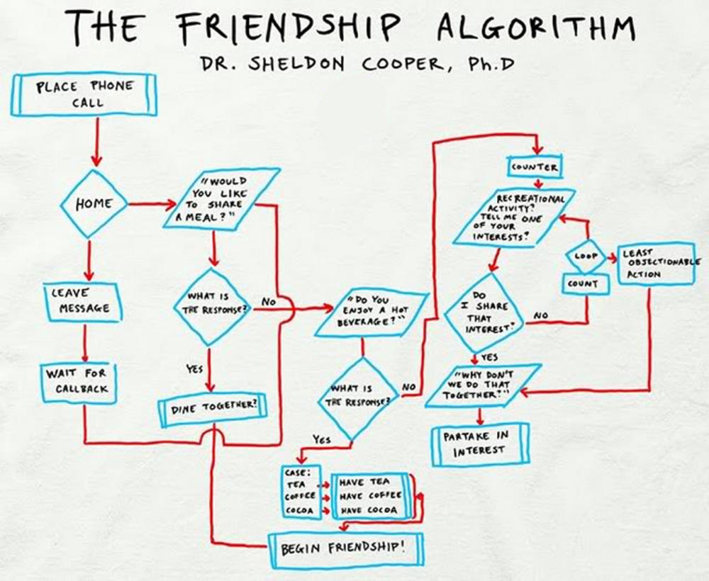
New terms that refer to things we already do

Slide 14
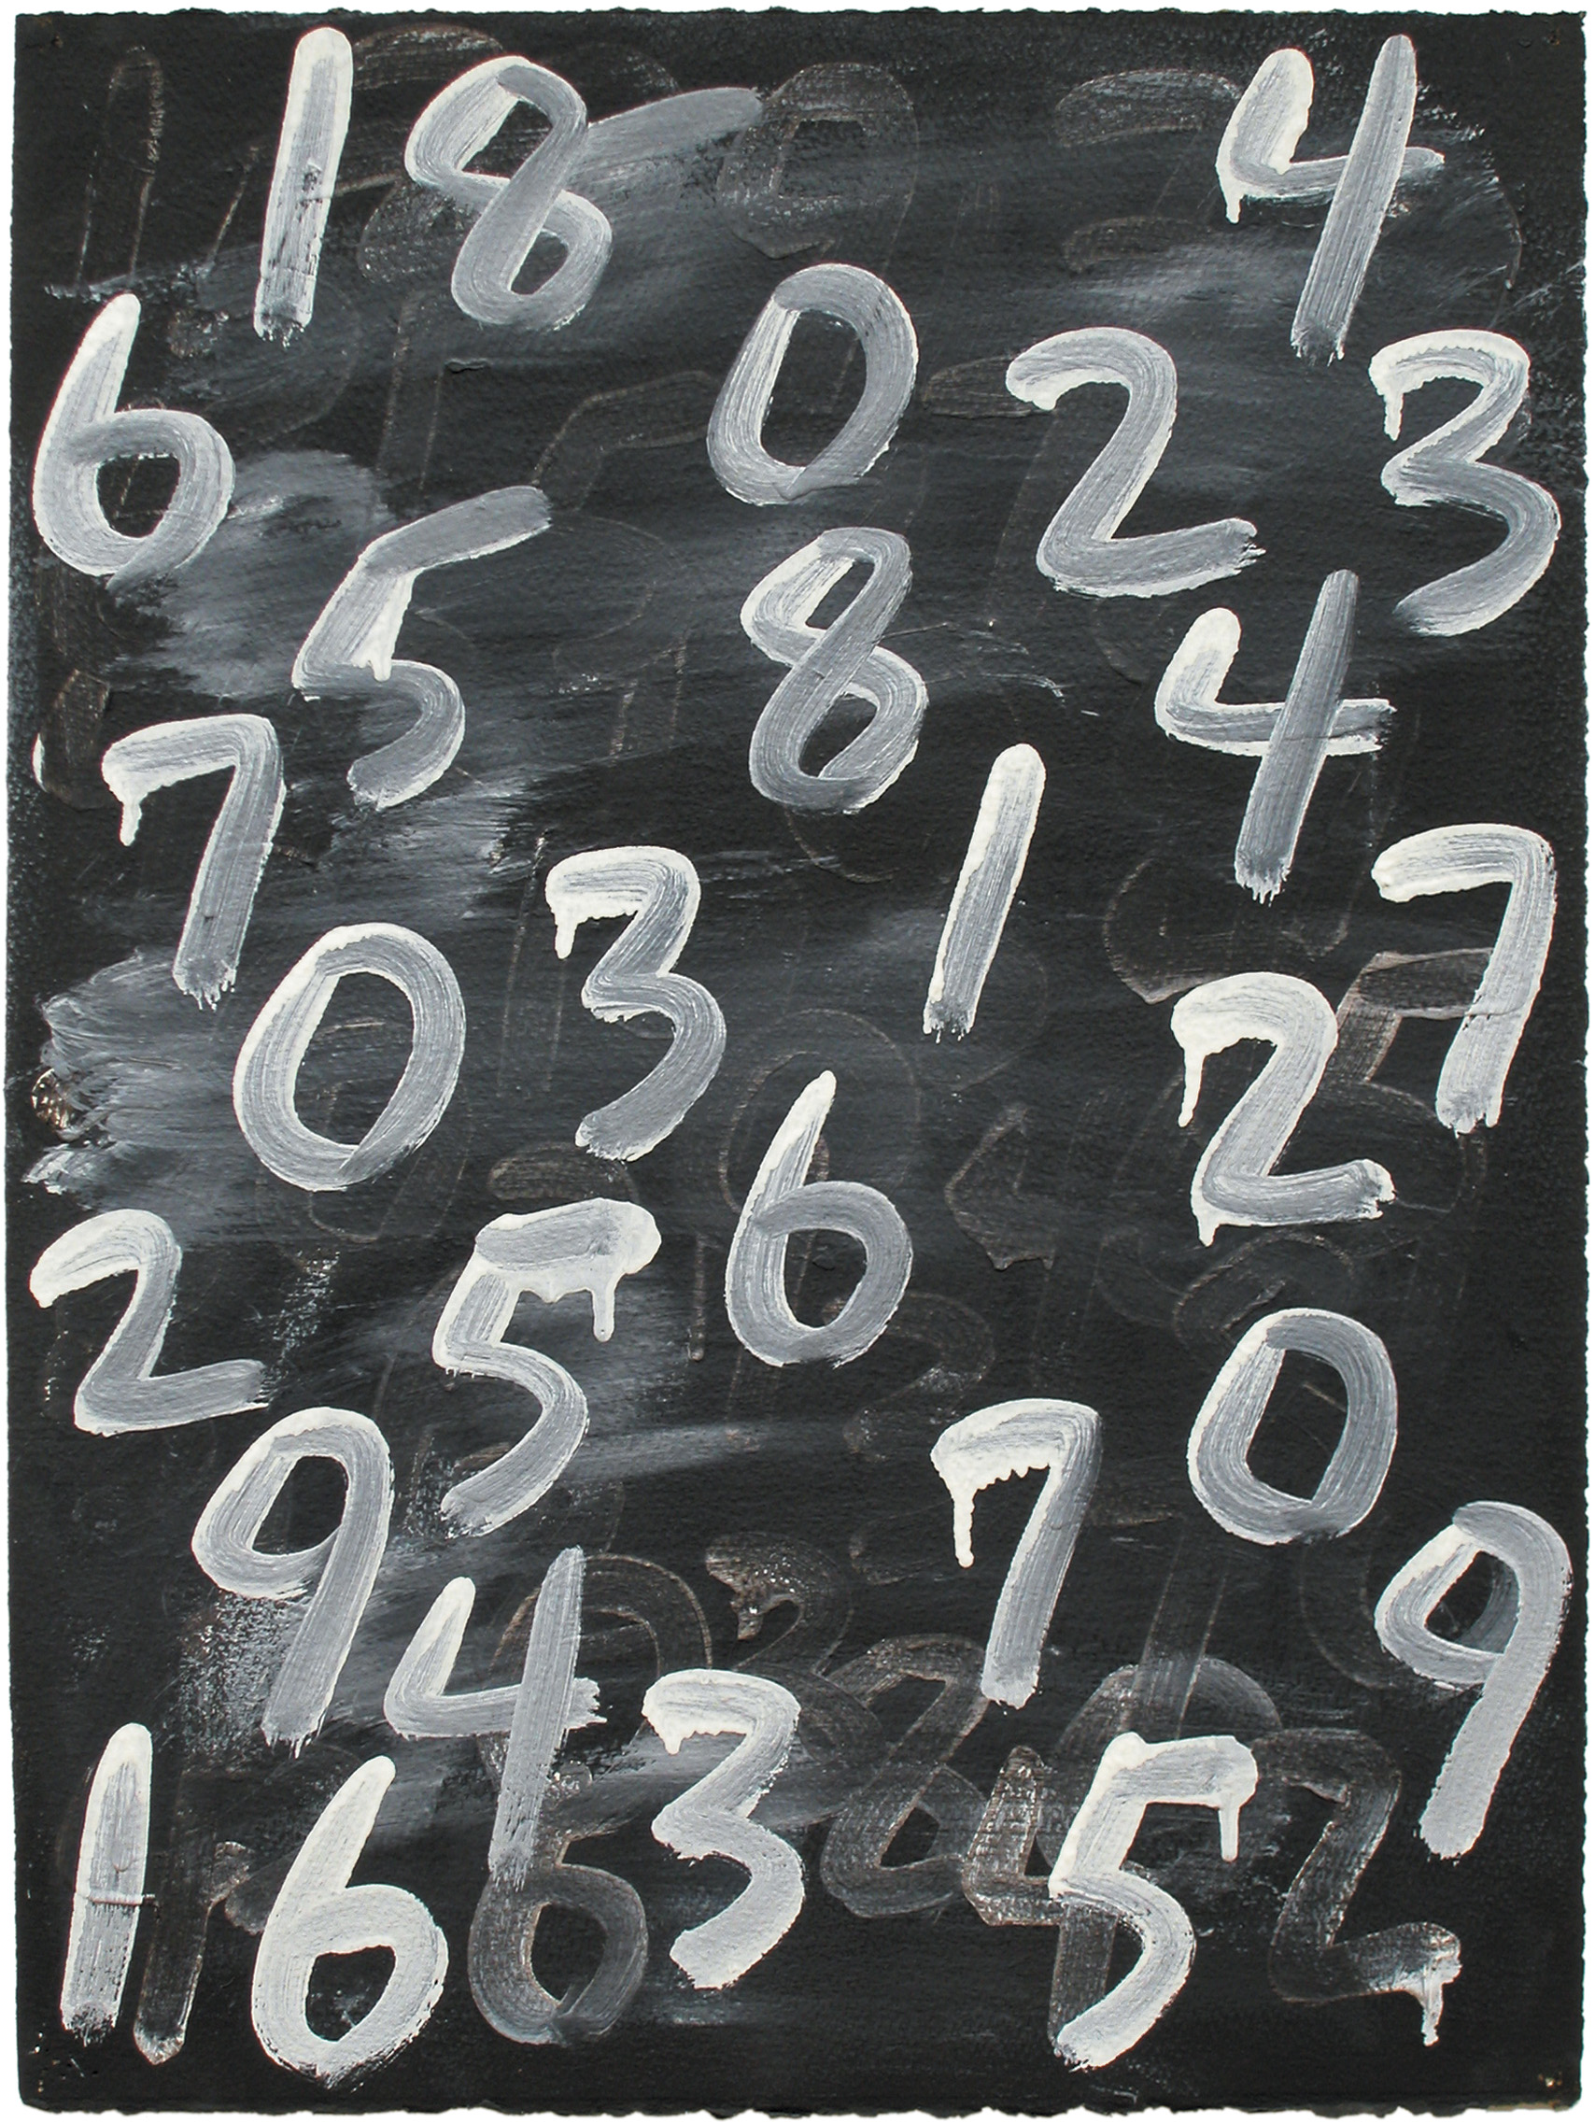
New terms that refer to things we already do
“Algorithm”
Refers to any step-by-step procedure that can be applied by a computer with a set of input & output
Example algorithm: Mean of a List
Input format: a list of integers
Process:
Create two new variables, both with value zero (0), called m and c.
For each value in the input list
Add that value to m
Add 1 to c
Divide m by c and return this value as output
Output: one real number – the mean

Slide 15

How is data analytics different from Statistics
A lot of data analytics can be considered computational statistics
More often that not when someone wants a data analyst (or even a data scientist) they want someone who can look at existing data and help them be: more efficient or more effective. Optimization (data analytics) vs. Summarization (statistics).
Make them more money

Slide 16
What is new in data analytics
Data analytics is the engineering task of taking ambiguous, ill-defined, or unclean information, quantifying it and drawing interesting relevant, generalizable and actionable insights from it.
The techniques used in data analytics create opportunities to analyze data in ways that decision makers have not previously thought of, allowing for the triangulation of evidence.

Slide 17
Data Analytics Course
Time
Course Introduction
Lecture
Statistics
Lecture
Data Analysis
Lecture
Review of What We’ve Learned
Break and 1-on-1 Instruction
Lecture
Lunch
Practicum
9:00 -10:30 am
10:30 -11:00 am
11:00 am - 12:30 pm
12:30 – 1:30 pm
1:30 - 3:00 pm
3:00 – 3:30 pm
Lecture
Break and 1-on-1 Instruction
Break and 1-on-1 Instruction
Data Management
Break and 1-on-1 Instruction
Machine Learning
Break and 1-on-1 Instruction
Lecture
Lecture
Lecture / Intro to R
Lecture
Lecture
3:30 – 5:00 pm
Break and 1-on-1 Instruction
Lunch
Practicum
Break and 1-on-1 Instruction
Practicum
Lunch
Introduction to R
Break and 1-on-1 Instruction
Introduction to R
Lunch
Statistics in R
Break and 1-on-1 Instruction
Statistics in R
Lunch
SQL with R
Break and 1-on-1 Instruction
SQL with R

Slide 18






Course Overview: Instructors

Slide 19

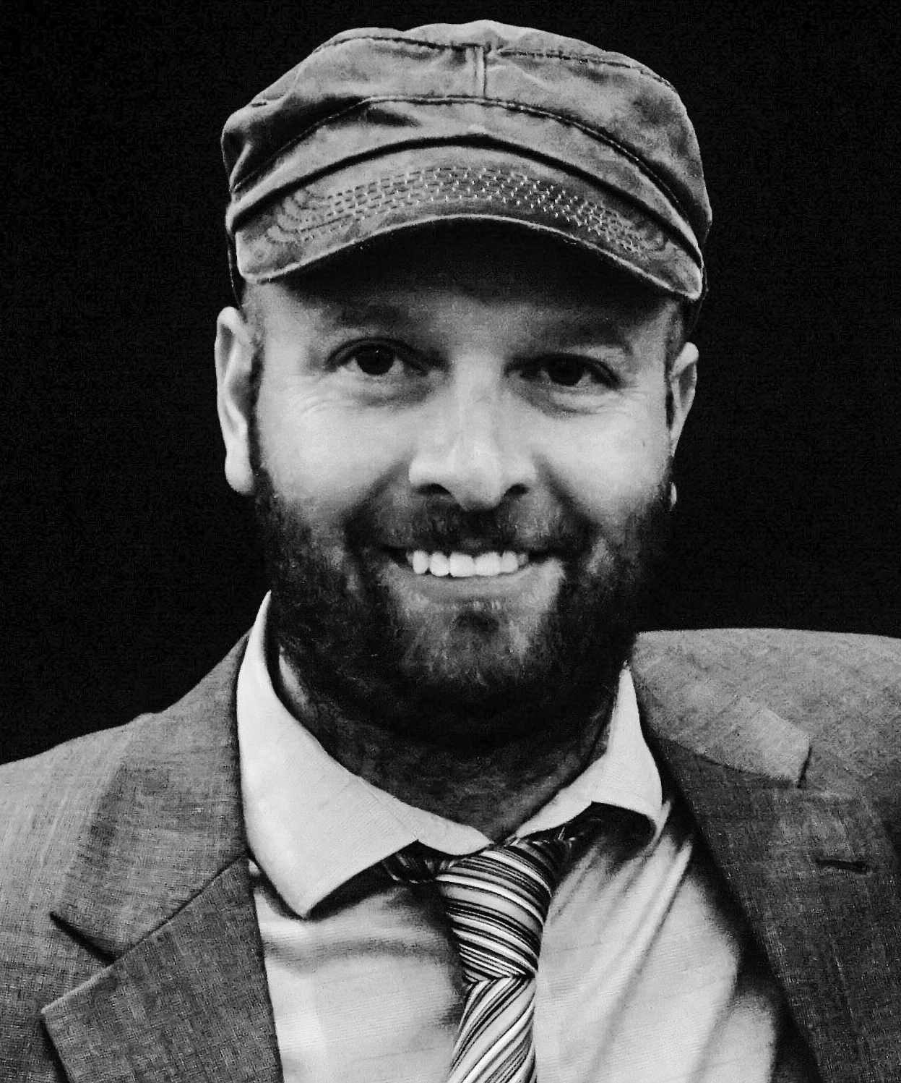
Dr. Andrew Collins
Old Dominion University faculty:
Engineering Management and Systems Engineering
Background:
PhD in Operations Research
Operations Research is the discipline of giving
analytical support to decision makers
Piece of Research Related To The Course:
Key Performance Indicators (KPI) for manufacturing
Traffic Incident Modeling

Slide 20


Dr. Jim Leathrum
Affiliation within Old Dominion University:
Department of Modeling, Simulation and Visualization Engineering
Background:
PhD in Electrical Engineering
Currently research is in modeling and simulation
Research Related To The Course:
T&E of autonomous systems
Tool for the analysis of inertia navigation systems

Slide 21

Dr. T. Steven Cotter
Affiliation within Old Dominion University:
Department of Engineering Management & Systems Engineering
Background:
PhD in Engineering Management & Systems Engineering
Currently research is in:
Engineering Design Analytics
Quality / Reliability Systems
Statistical Engineering
Research Related To The Course:
Design Analysis - How can data from many different sources and stakeholders be combined to discover or create new design patterns that provide functional utility and strategic advantage within a mission context?

Slide 22


Christopher Lynch
Affiliation within Old Dominion University:
Virginia Modeling, Analysis & Simulation Center
Background:
MS in Modeling and Simulation
Currently research is in simulation verification / social simulation
Piece of Research Related To The Course:
Investigating temporal and spatio-temporal effects
on tourists’ emotions when visiting cities’ tourist destinations

Slide 23

Dr. Ross Gore
Affiliation within Old Dominion University:
Virginia Modeling, Analysis & Simulation Center
Background:
PhD in Computer Science
Current research is in data science / predictive analytics
Piece of Research Related To The Course:
Predicting the the obesity rate in US cities based
on 3 measures of geo-tagged tweets

Slide 24
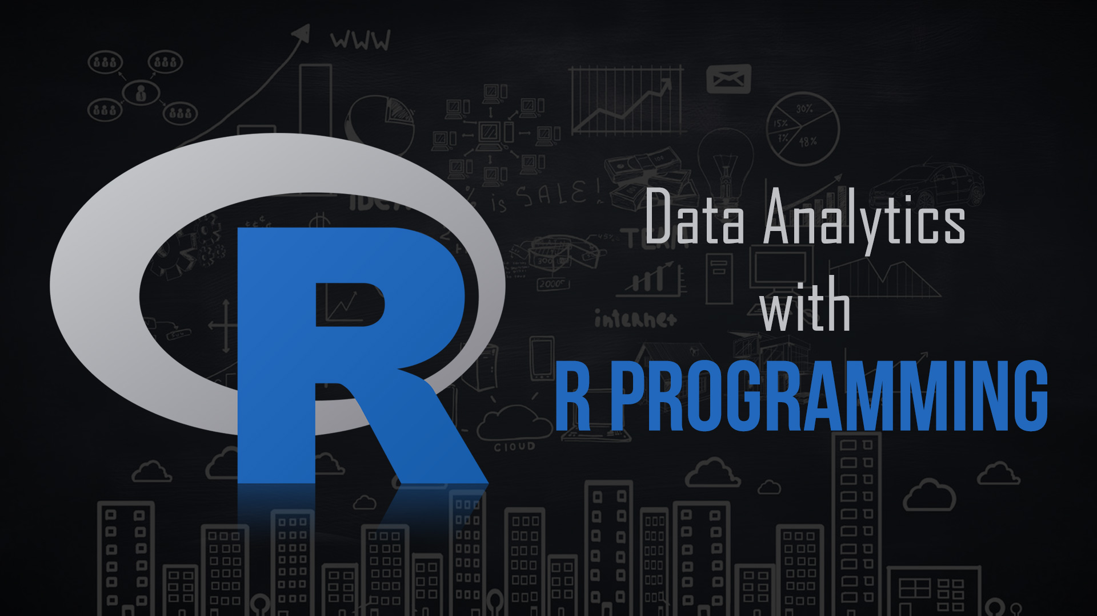
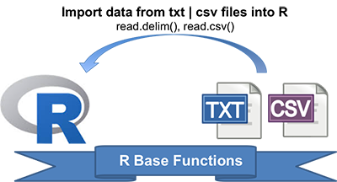
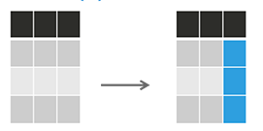
Course Overview: Monday

Slide 25
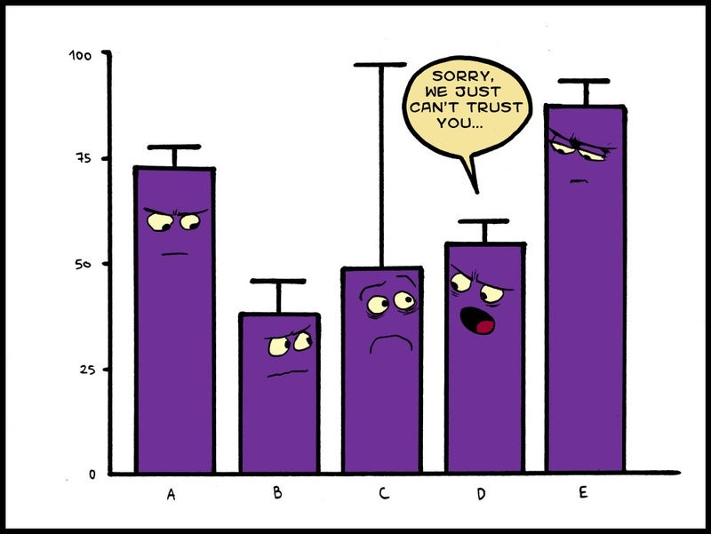
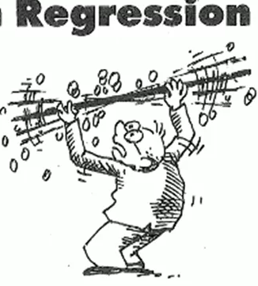
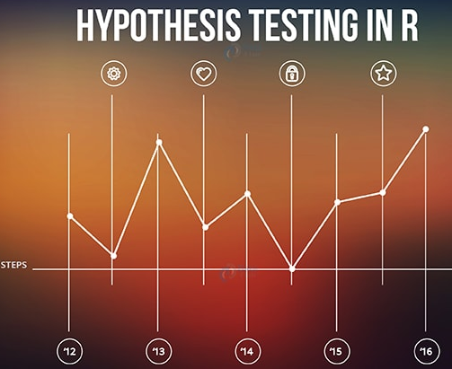
Course Overview: Tuesday

Slide 26
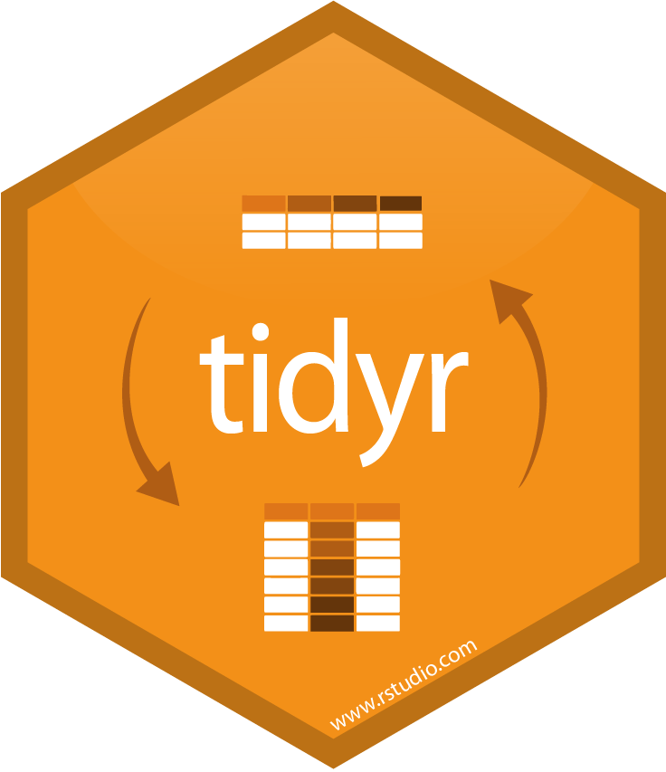
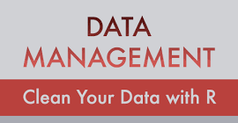
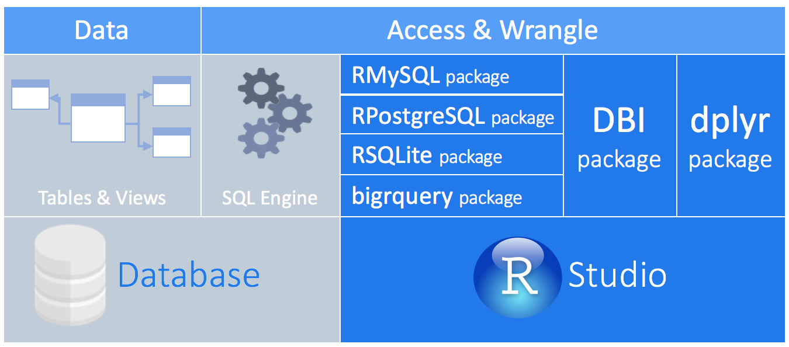
Course Overview: Wednesday

Slide 27

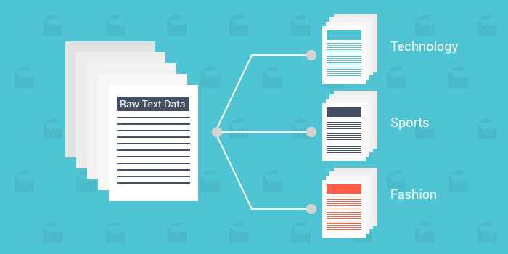
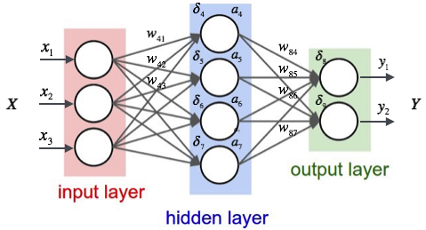
Course Overview: Thursday

Slide 28
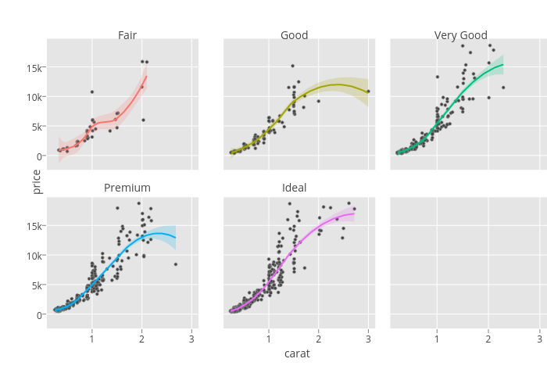
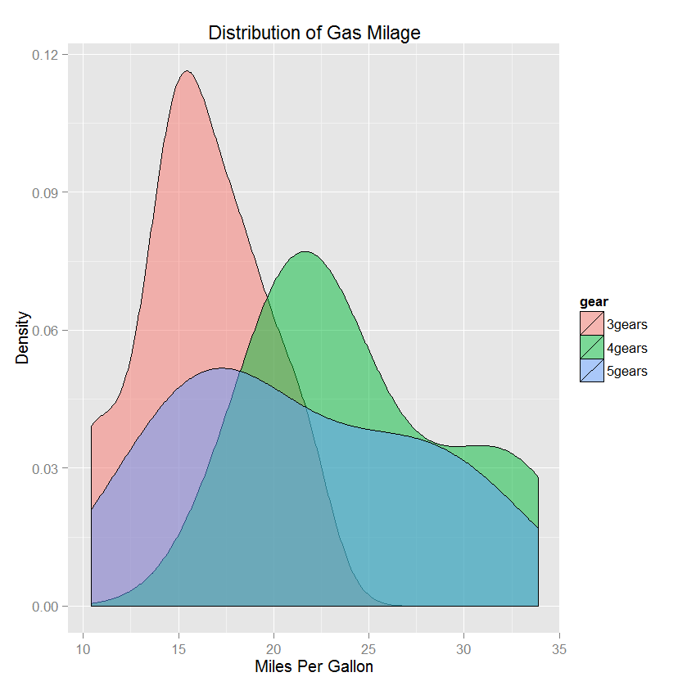

Course Overview: Friday

Slide 29

Overall: What you will learn
Import Data
Clean Data
Transform/Analyze/Manage Data:
Create new variables
Understand and summarize variables
Manage and query data with SQL
Visualize Data
Model Data
Communicate the data to enable better decisions

Slide 30

Overall: What you will not learn
Big Data – Hadoop / Map Reduce
Non-Rectangular Data – Images, Sounds
Note: We do some text analysis
Focus on Hypothesis Generation vs. Hypothesis Confirmation
We will help you look deep into the data to generate ideas that explain what is happening
We are not focused on confirmatory analysis of an established statistical model
Note: We do some hypothesis testing
Programming in non-R languages

Slide 31


Why not excel
The draw of the spreadsheet is strong.
The first killer app
Interface mixes together (creates confusion):
Data entry (input)
Data analysis
Output
Interaction-driven nature thwarts:
automation
reproducibility

Slide 32
Why R instead of Excel
Data Manipulation
A majority of the time spent on analysis is spent before analysis begins (i.e. data preparation)
Easier automation:
Scripts instead of GUI
Magnified when you rerun analysis
Reproducibility
Easier to identify errors
Flexibility in terms of types of data read
.txt, .csv, .dat, JSON, Excel, SPSS, SAS, STATA
The Navy is encouraging you to!
Approved Software
Will be pushed to your environment shortly.

Slide 33
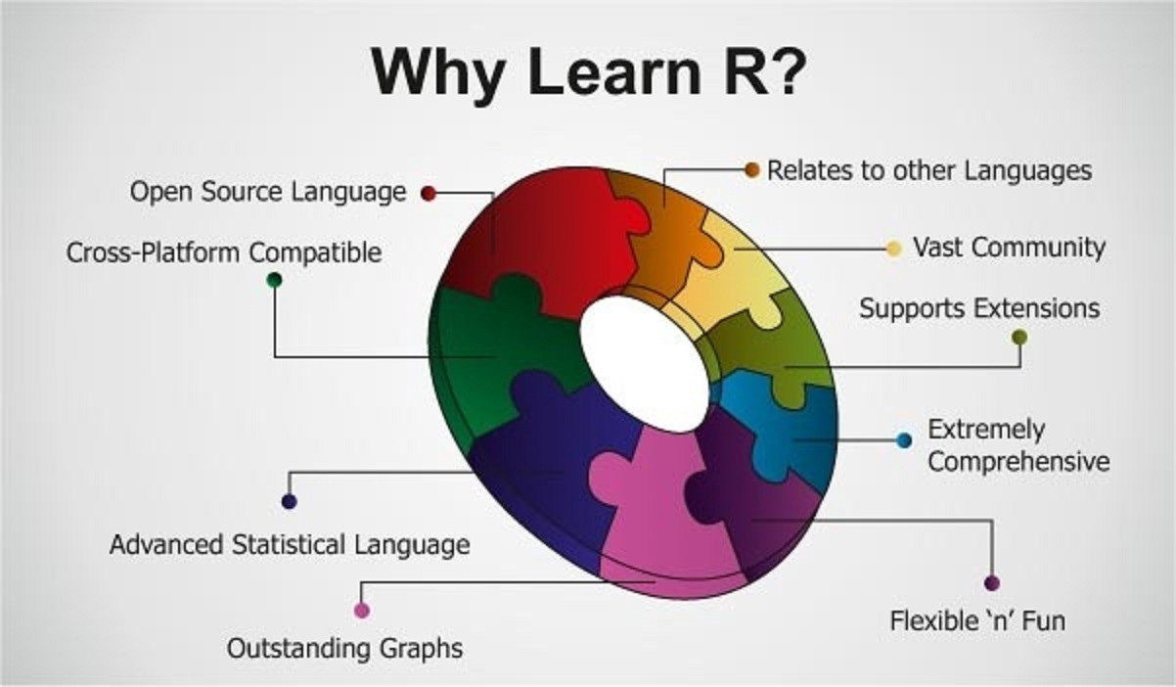
Course Technology: R

Slide 34
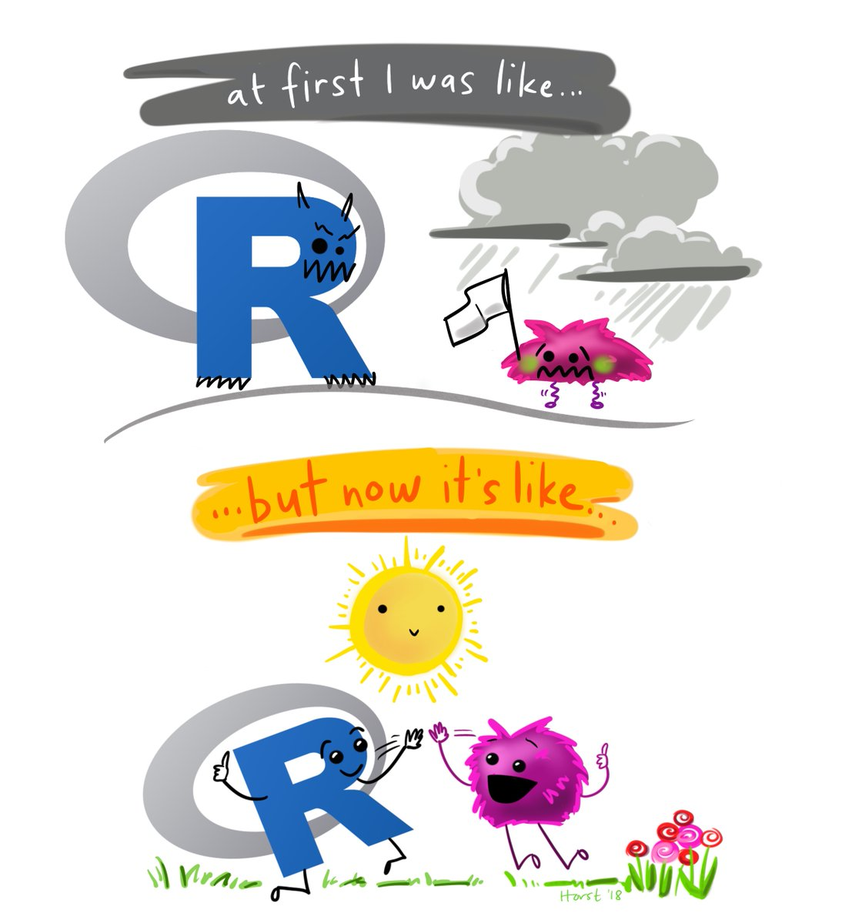
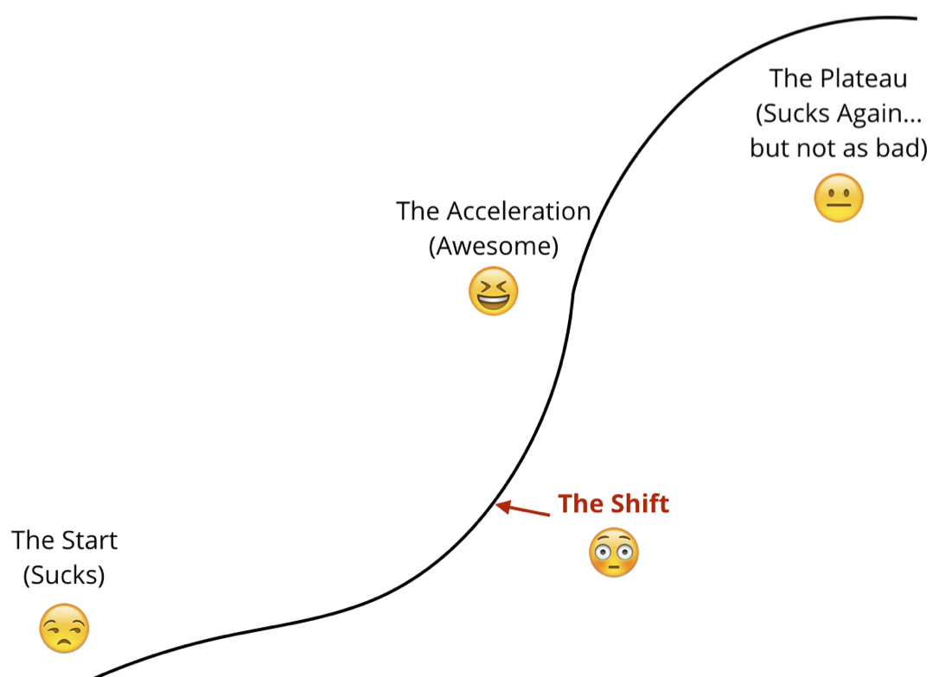
R Learning Curve
Things may seem frustrating at first
You are learning a new language
Stick w/ us! The shift will happen!
Intensive nature of course will help

Slide 35
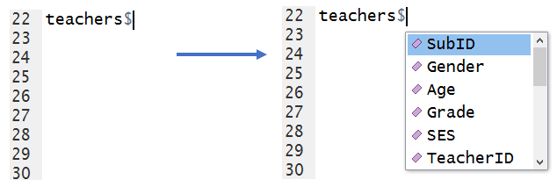
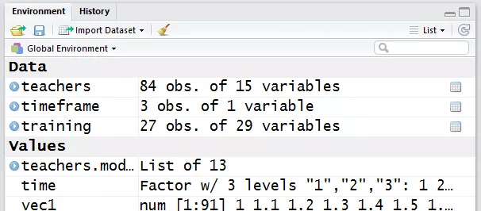
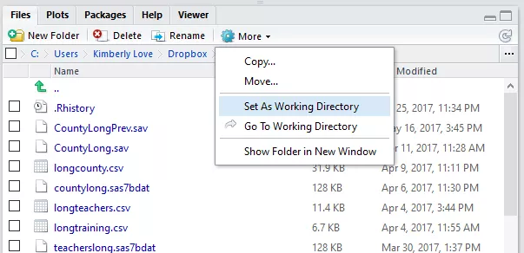
RStudio To the Rescue
R and RStudio are two different things
R is a language and environment for data analytics that includes the ability to create effective graphics
RStudio is R-Studio is a free and open-source integrated development environment (IDE) for R
RStudio helps you:
write scripts (automatic completion)
view and interact with the objects stored in your environment.
set your working directory and access files on your computer.
display graphics you create.
RStudio is as close to Excel as you will get this week. Without RStudio, things would feel even less familiar.

Slide 36
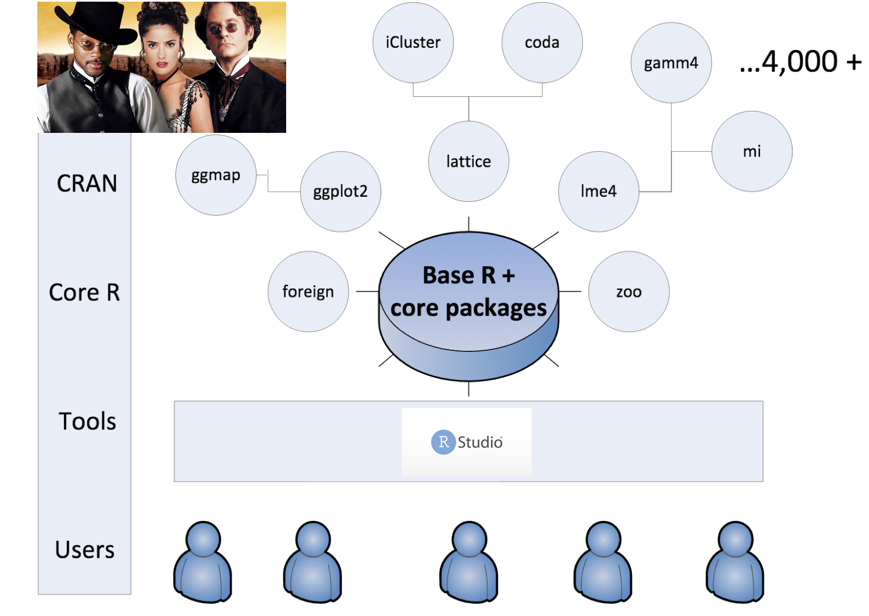
The R Landscape: R and R Packages
R is powerful because of the extensive set of additional packages.
If you have a problem there is almost definitely a package for it.
Base R comes w/ some packages.
Packages on CRAN is a distributed repository of R packages that have been reviewed for suitable testing and documentation and accepted.
Other packages are not necessarily as well supported.

Slide 37
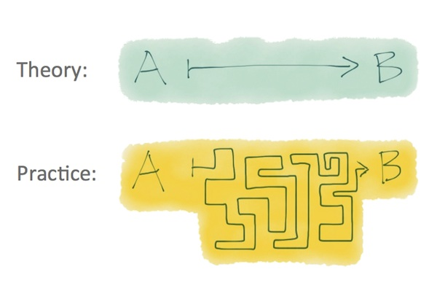
Start Thinking About Your Practicum Project
We have some data that should be of some importance to you
What questions do you have about it?
Future predictions related to it
Statistically significant differences between subjects within it
Explore it in a new way to get insight
Develop a model to classify future entries

Slide 38
Start Thinking About Your Practicum Project
Your work with this data set at the end of the week will serve as your exam.
The earlier you know what you want to work with and what questions you want insight into the sooner you can ask questions and start to think to answer the question.
This will put you in a better position for success and understanding.

Slide 39
Revisiting: Administrivia
You should:
Have a computer in front of you
Have R installed on that computer
Have a connection to the internet
If you do not have all of these three please let us know so we can start trouble shooting ASAP.

